Slide 1
Inventory management system
Created by: Aswene SIVARAJ

Slide 2
Introduction
Scope

Slide 3
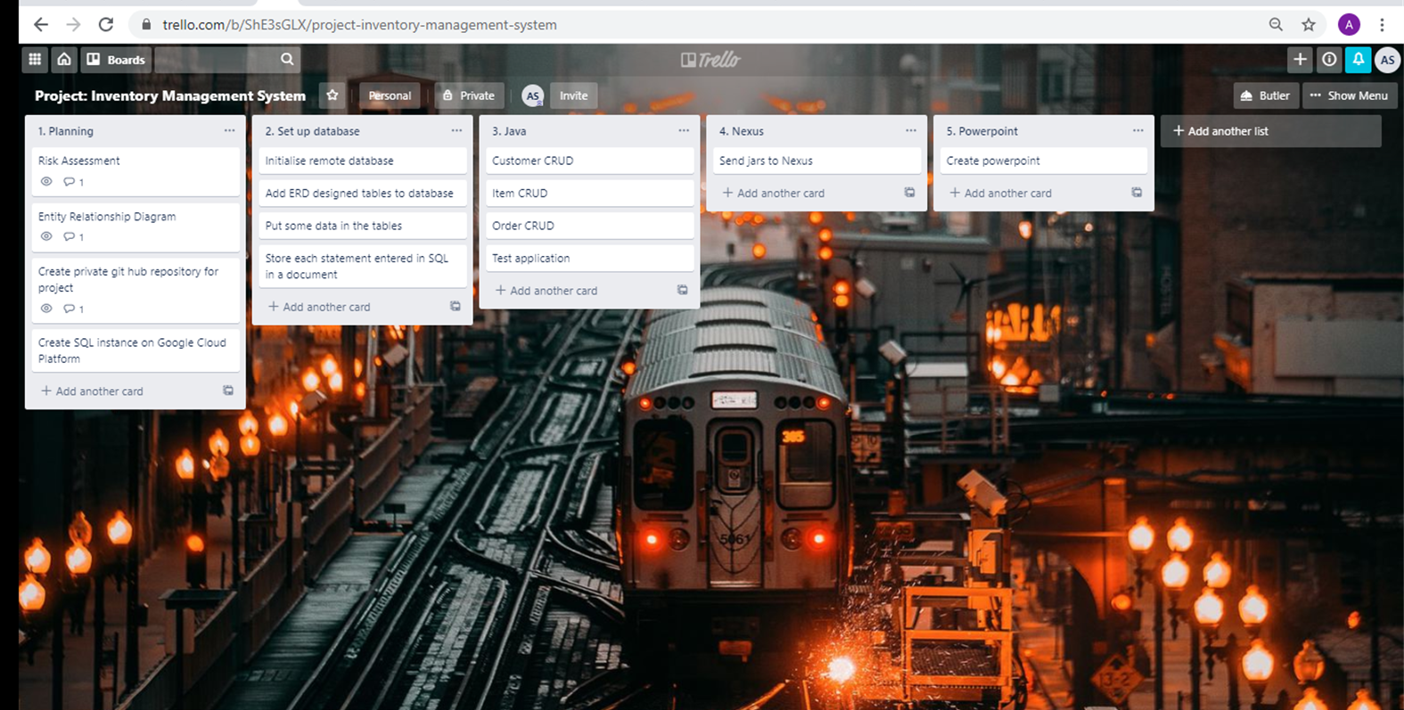
Initial Plan

Slide 4
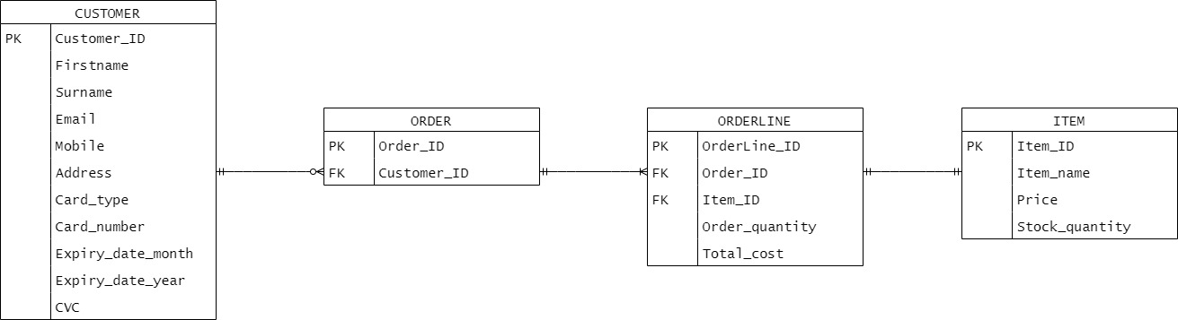
Entity Relationship diagram
Customer to order: 0-to-many
Order to orderline: 1-to-many
Orderline to item: 1-to-1
Item to orderline: 1-to-1
Orderline to order: 1-to-1
Order to customer: 1-to-1

Slide 5
Technologies
Which technologies and concepts will be used

Slide 6
NEXUS
Notes:
Screenshot of fat .jar --- pom file

Slide 7
Uploading to git
Notes:
Screenshot of commits

Slide 8
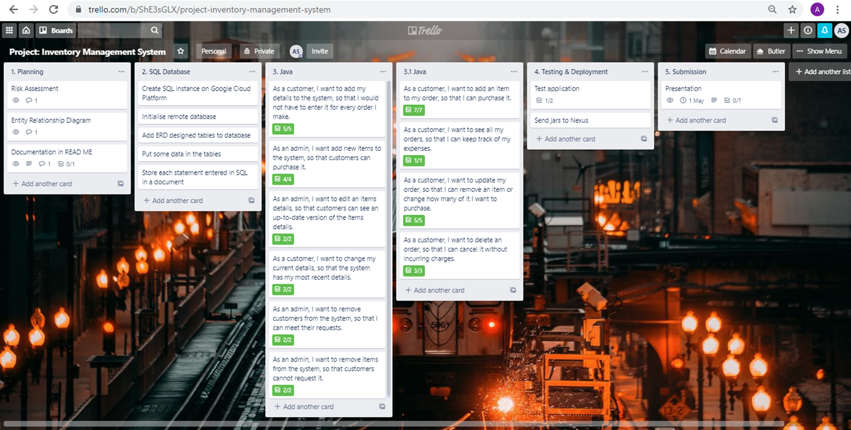
Review
Notes:
Demo of application
What was completed? Insert “after” Kanban board

Slide 9
conclusion & Further work
Sprint retrospective/conclusion: what did you do well? What can you improve?

Slide 10
THANK YOU FOR LISTENING! ANY QUESTIONS?

